Slide 1
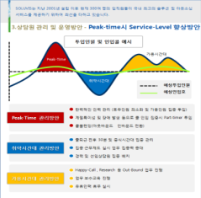
품질 관리 PROCESS
STEP 02
TITLE
STEP 03
TITLE
STEP 04
TITLE
STEP 01
TITLE
RESULT
TITLE 01
TITLE 02
TITLE 03
품질 평가결과
TITLE 04
Step1 contents 01
Step1 contents 02
Step1 contents 03
Step2 contents 01
Step2 contents 02
Step2 contents 03
Step3 contents 01
Step3 contents 02
Step3 contents 03
Step4 contents 01
Step4 contents 02
Step4 contents 03
Step5 contents 01
Step5 contents 02
Step5 contents 03
제품생산 표준화, 객관화
운영안정화 교육
보완교육
결과보고서
고품질
제품제공
contents 01
contents 02
contents 03
contents 01
contents 02
contents 03
contents 01
contents 02
contents 03

